Slide 1

Concurrency and Multi-threading in Embedded Systems
Maximizing Performance and Responsiveness

Slide 2
Agenda
Introduction
Key Concepts
Thread Management
Synchronization Mechanisms
Inter-Process Communication (IPC)
Best Practices
Conclusion
Q&A

Slide 3
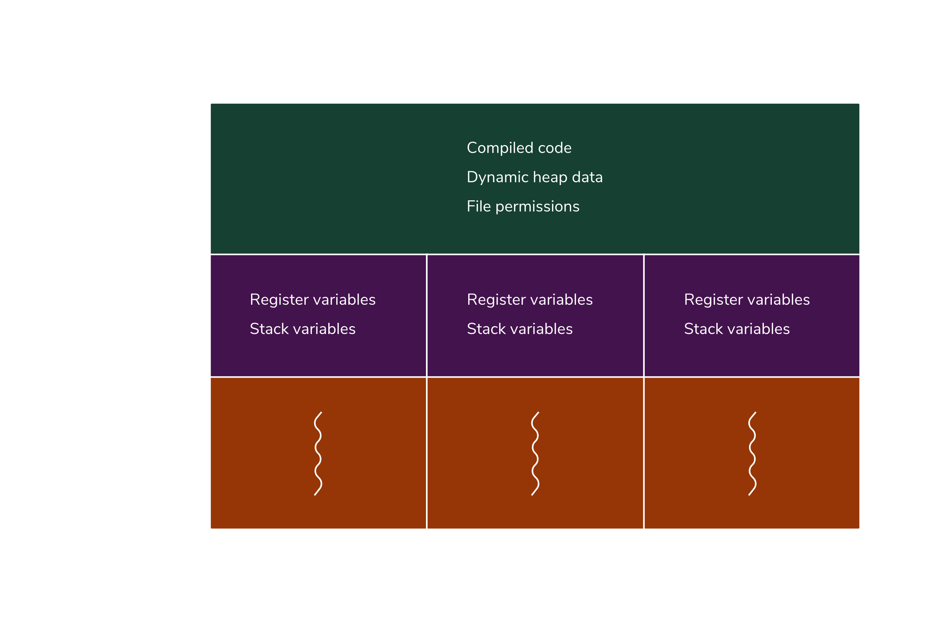
Introduction: Process and Thread
Concurrency and multithreading are closely related concepts, often used to optimize performance and responsiveness in applications.
What is Process?
A process is an instance of a computer program that is
getting executed.
Each process operates independently, requiring its
own isolated memory space.
What is Thread?
Thread is an execution unit that is part of a process.
Threads share the same address space, code, and resources within the process.
Each thread has its own program counter, a stack, and a set of registers but shares the overall memory.

Slide 4
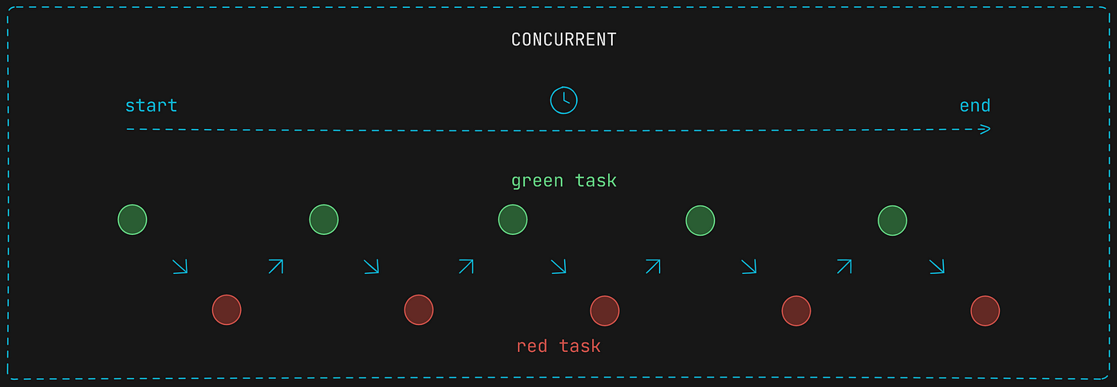
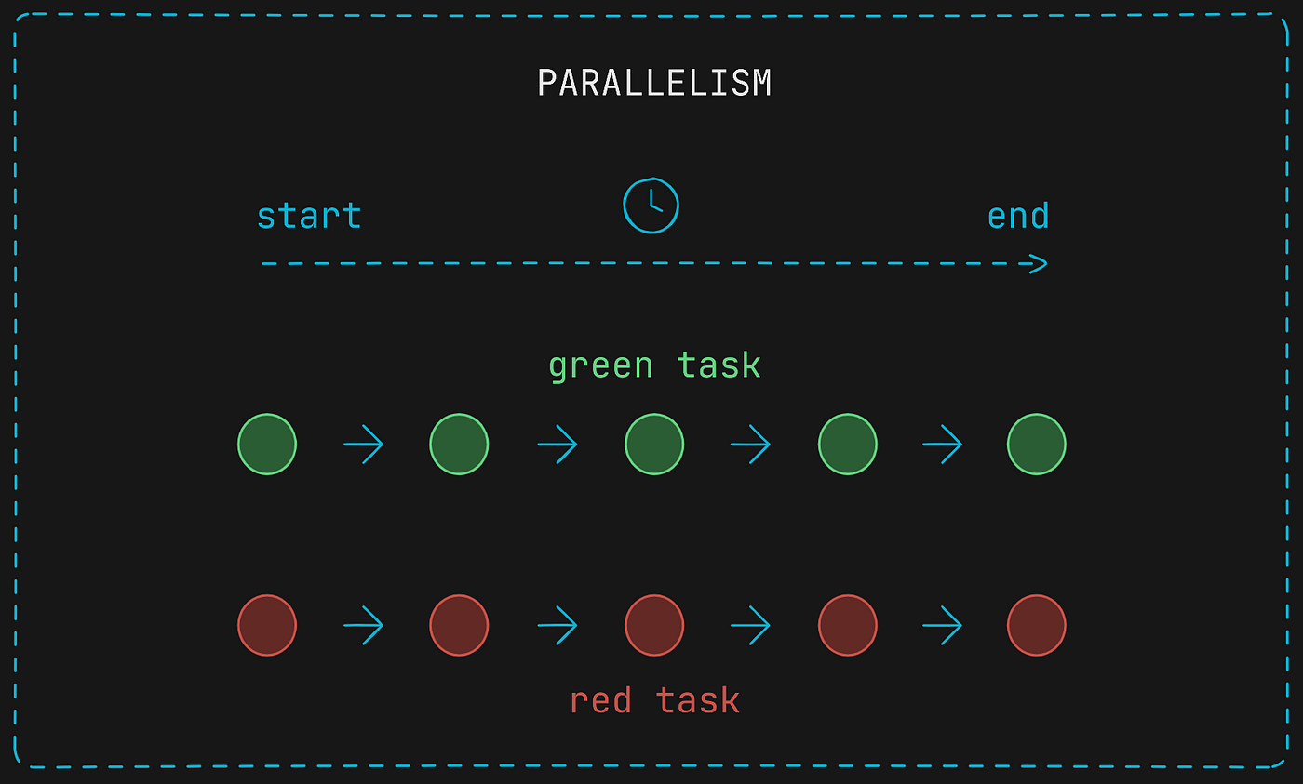
Introduction: Concurrency and Multithreading
Concurrency is about dealing with lots of things at once (interleaving)
Including parallelism (using multiple processors).
Interleaved processing (time-slicing on a single processor).
Even distributed processing across multiple machines.
Multithreading is a form of concurrency where multiple threads run in parallel on multi-core processors.
It allows true parallel execution of tasks.
Data Parallelism: Same operation on different pieces of data
Example: SIMD (Single Instruction, Multiple Data)
Task Parallelism: Different tasks executed in parallel.
Example: Web server handling multiple client requests

Slide 5
Introduction: Concurrency v/s Multithreading
Practical Use Cases in Embedded Systems
Multithread - High-speed data processing for real-time applications.
Audio and video codecs in embedded multimedia devices.
Concurrency - Allows other tasks to proceed while waiting for I/O operations to complete.
An embedded device reading sensor data while simultaneously updating a display.
Concurrency | Multithreading
Dealing with lots of things at once (interleaving). | Doing lots of things at once (simultaneous execution).
Improve the responsiveness and resource utilization of a system. | Increase the computational speed of tasks.
Single-core processor through context switching. | Requires multiple cores or processors.

Slide 6
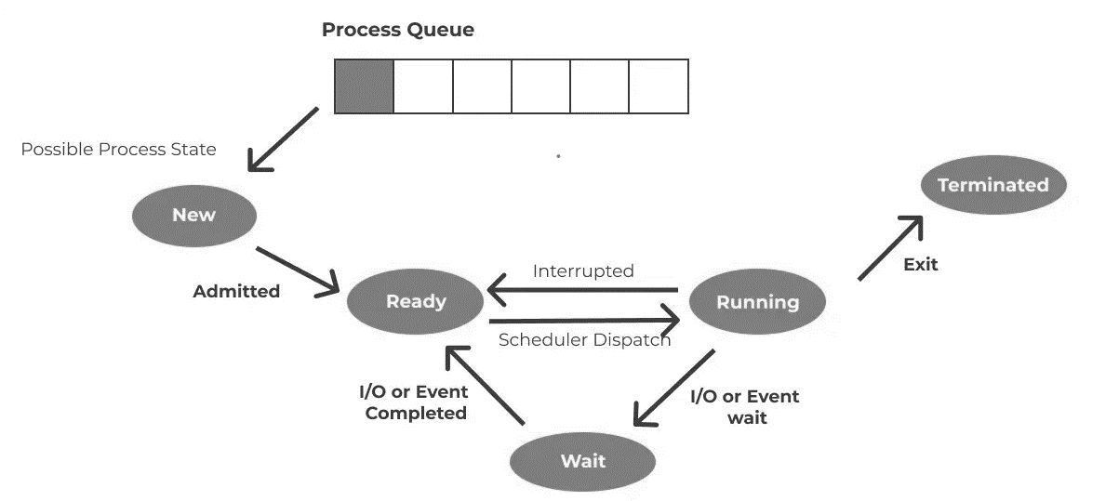
Key Concepts: Process States and Lifecycle

Slide 7
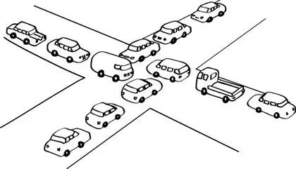
Key Concepts: Deadlock
A deadlock is a situation where a set of processes are blocked, each waiting for resources held by other processes in a circular chain.
Causes:
Mutual Exclusion:
Resources cannot be simultaneously used by multiple processes.
For example, if one process holds a resource (like a printer), others must wait.
Hold and Wait:
Processes can hold resources while waiting for additional ones.
A process may request new resources without releasing the ones it already holds.
No Preemption:
Resources cannot be forcibly taken away from a process.
If a process is holding a resource, it won’t be preempted.
Circular Wait:
There exists a circular chain of processes, each waiting for a resource held by the next process in the chain.

Slide 8

Key Concepts: Race Condition
A race condition occurs when the outcome of a program depends on the sequence or timing of uncontrollable events.
Causes:
Concurrent Execution:
Multiple threads or processes accessing shared data simultaneously.
Lack of coordination can lead to conflicts and data corruption.
Lack of Synchronization:
Absence of mechanisms (e.g., locks, semaphores) to coordinate access to shared resources.
Threads may interfere with each other, causing race conditions.
Uncertain Timing:
Execution order of threads or processes is unpredictable.
Assumptions about sequence can result in unexpected behavior.
Impact:
Data Corruption: Inconsistent or incorrect data due to simultaneous access.
Program Instability: Unpredictable behavior leading to crashes or errors.
Debugging Complexity: Difficult to reproduce and diagnose because outcomes vary with timing.

Slide 9
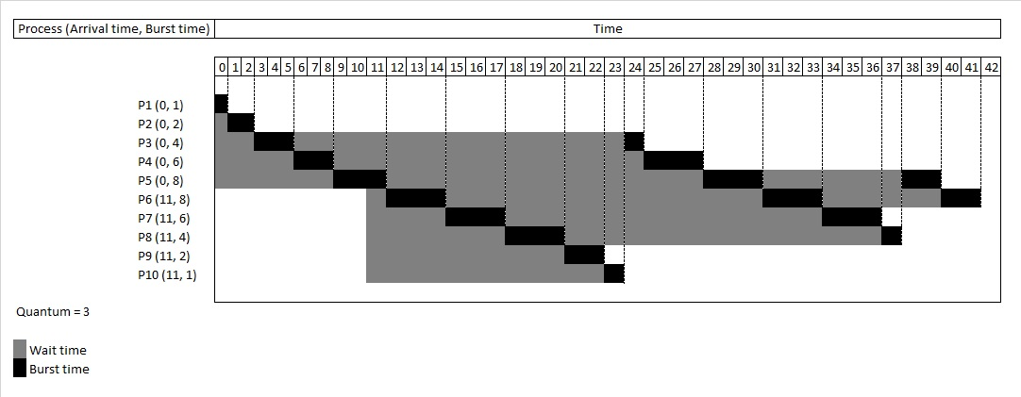
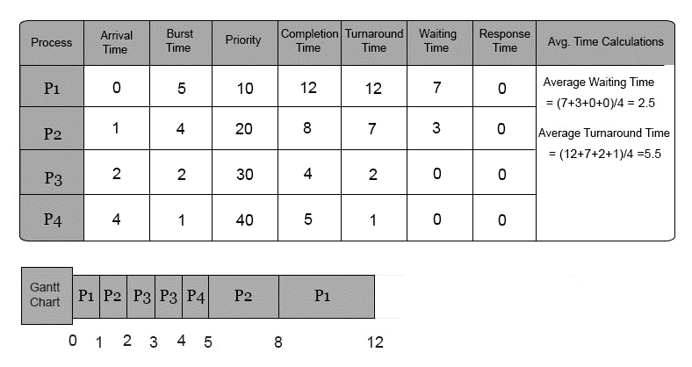
Thread Management
Thread management involves handling multiple threads within a process.
Efficient thread management is crucial for optimizing performance and resource utilization in embedded systems.
Round-robin Scheduling:
Definition: Each thread is given an equal
share of CPU time in a cyclic order.
Usage: Common in non-real-time systems
to ensure fairness in task execution.
Priority-based Scheduling:
Definition: Threads are assigned priorities, and the scheduler executes higher-priority threads before lower-priority ones.
Usage: Critical for real-time systems where tasks have strict timing requirements.
User Space vs. Kernel Space
User space: Thread management via thread library.
Blocking system calls affect the entire process.
Kernel space: Only one thread at a time can execute in kernel mode.

Slide 10
Synchronization Mechanisms
Why Synchronization?
Synchronization coordinates the execution of multiple processes or threads.
Ensures controlled access to shared resources.
Common Needs:
Prevent race conditions where multiple threads access shared data simultaneously.
Coordinate access to shared resources to maintain data consistency.
Synchronize threads to avoid deadlock scenarios.
Techniques:
Mutexes: Mutual exclusion locks.
Semaphores: Counting or binary synchronization.
Condition Variables: Thread coordination.

Slide 11
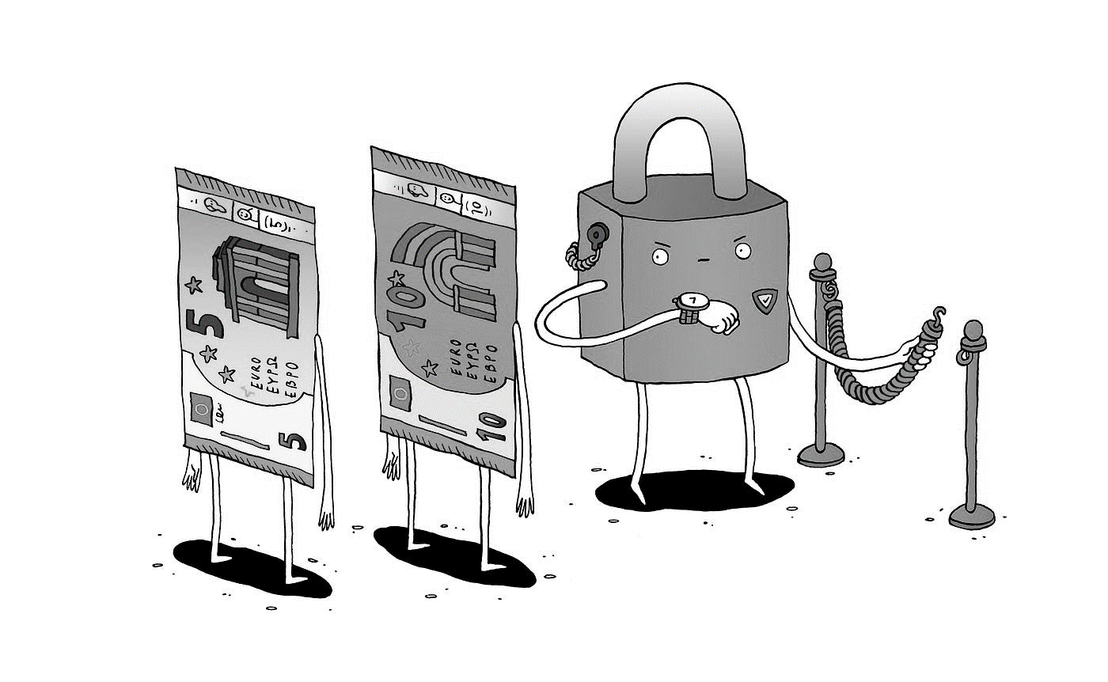
Synchronization Mechanisms: Mutexes
What is a Mutex?
A mutex (short for mutual exclusion) is a synchronization mechanism used to coordinate access to shared resources.
Only one task can acquire the mutex at a time.
Ownership is associated with a mutex, and only the owner can release the lock (mutex).
How Does It Work?
Locking:
When a thread or process wants to access a shared resource,
it requests the mutex lock.
If the mutex is available (not held by another thread), the requesting
thread acquires it.
Otherwise, the requesting thread blocks until the mutex becomes available.
Unlocking:
When the thread or process finishes using the shared resource, it releases the mutex.
Other threads waiting for the mutex can then proceed.

Slide 12
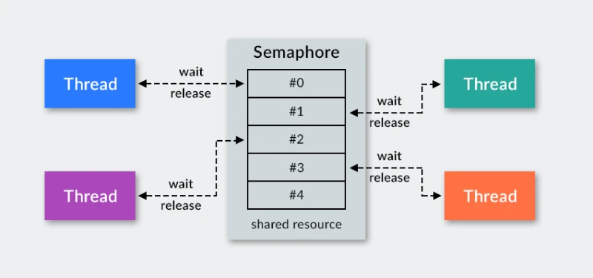
Synchronization Mechanisms: Semaphores
What are Semaphores?
Semaphores are normal variables used to coordinate the activities of multiple processes in a computer system.
They enforce mutual exclusion, avoid race conditions, and implement synchronization between processes.
Semaphore Operations:
Wait (P) Operation:
Decrements the value of the semaphore.
Blocks the process if the semaphore value is zero.
Signal (V) Operation:
Increments the value of the semaphore.
Activates a blocked process or increments the semaphore.
Types of Semaphores:
Binary Semaphore (Mutex):
Values: 0 or 1.
Ensures mutual exclusion for critical sections.
Counting Semaphore:
Unrestricted domain.
Controls access to resources with multiple instances.

Slide 13
Inter-Process Communication (IPC)
IPC refers to the mechanisms and methods used by various processes to communicate and synchronize their actions.
Types:
Shared Memory: Processes share a portion of memory for fast data exchange.
Message Passing: Processes communicate by sending and receiving messages via a shared queue or mailbox.
Pipes and FIFOs: Unidirectional communication channels between processes.
Sockets: Communication between processes over a network or locally using IP protocols.
Signals: Basic form of IPC using signals to notify processes of events or interrupts.
Usage Scenarios:
Client-Server Communication: Essential for applications where multiple clients interact with a central server.
Parallel Processing: Allows processes to work concurrently, exchanging data to achieve a common goal.
Real-Time Systems: Critical for systems requiring precise timing and data synchronization.
Distributed Computing: Enables communication between processes running on different machines.

Slide 14
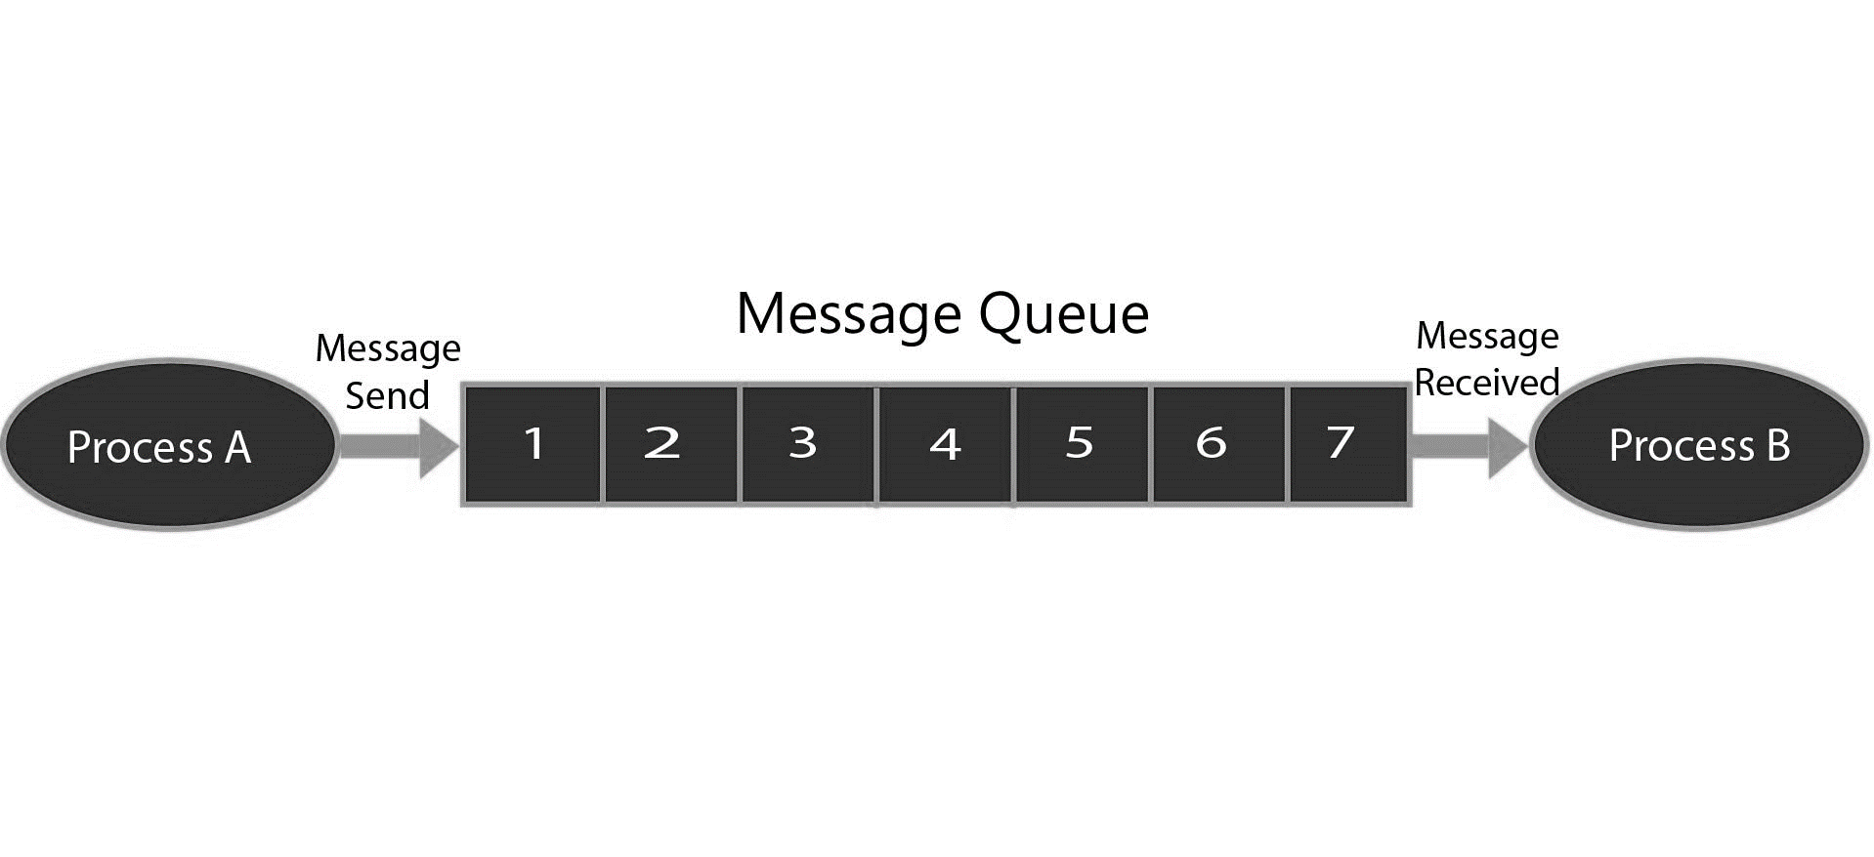
IPC: Message queue
A form of IPC where processes communicate by sending messages to a common queue.
Messages are stored in a queue, waiting to be processed, and are deleted after processing.
How It Works:
A linked list of messages is stored within the kernel, identified by a unique message queue identifier.
Processes can add messages to the end of a queue using msgsnd().
Messages are fetched from the queue using msgrcv().
System Calls for Message Queues:
ftok(): Generates a unique key.
msgget(): Creates or opens a message queue.
msgsnd(): Adds data to a queue.
msgrcv(): Retrieves messages from a queue.
msgctl(): Performs operations on a queue (e.g., destroying it)

Slide 15
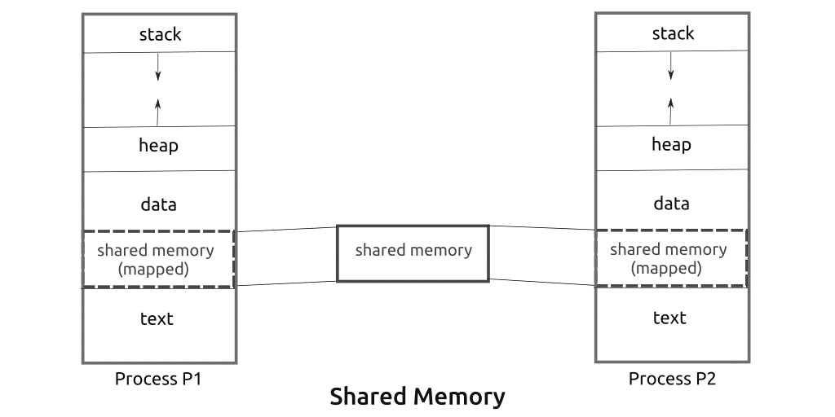
IPC: Shared Memory
Shared memory is an IPC mechanism where two or more processes can access a common memory segment.
Changes made by one process are visible to other processes sharing the same memory segment.
How It Works:
Processes set up a region of their virtual memory for shared memory communication.
The process requests the kernel to make this region shared.
Other processes can then read from or write to this shared memory segment.
System Calls for Shared Memory:
ftok(): Generates a unique key.
shmget(): Creates or opens a shared memory segment.
shmat(): Attaches a process to the shared memory.
shmdt(): Detaches a process from shared memory.
shmctl(): Performs operations on shared memory (e.g., destruction).

Slide 16
Best Practices
Effective Use of Synchronization Mechanisms.
Tip: Use mutexes and semaphores judiciously to avoid excessive blocking.
Example: Only lock critical sections of code.
Avoiding Common Pitfalls.
Deadlocks: Ensure proper order of acquiring locks.
Example: Use a consistent locking order to prevent circular wait.
Race Conditions: Protect shared resources.
Example: Use atomic operations or locks.
Minimize context switching.
Testing and Debugging Multithreaded Applications.
Tool: Use tools like Valgrind, Helgrind, or ThreadSanitizer
Technique: Stress testing with different thread counts and workloads

Slide 17




THANK YOU
Do you have any questions?
pratikparvati@gmail.com
https://pratikparvati.com/

